Slide 1
CSc 134
Database Management Systems
1. Introduction to Database Management Systems
Ying Jin
Computer Science Department
California state University, Sacramento

Slide 2
Database Management Systems
Database
  A database is a collection of related data .
Database management System (DBMS)
  A database management system is a collection of programs that enables users to create and maintain a database.

Slide 3
File Processing System versus DBMS
Redundancy
  Duplication, Waste Storage, Inconsistent
Security
  Beyond that provided by operating system
  Authorized Access
Self-Describing
  Stores data, definition of database structure and constraints
Integrity Constraints
  Data type, relationships, uniqueness

Slide 4
File Processing System versus DBMS (Cont.)
Data abstraction
  A change in a file system requires a change in the program.
  A conceptual representation of data without details of physical storage
Multiple views
  A DBMS supports multiple users to view the database in different ways.
  A view may be a subset of the database, or contain virtual data derived from the database (not explicitly stored).
Concurrency control
Efficient query processing

Slide 5
Database Users
Database Administrators (DBA)
  Manage database and related software.
  e.g. Monitor use of resource, authorized access to the database, and system performance
Database Designers
  Design the structure to represent and store data
  Identify the data to be stored
End Users
  Casual end user: use sophisticated database query language
  Naïve user: menu-driven interface
  Sophisticated end users: familiar with DBMS to implement their applications.

Slide 6
Data Models
Data Model: A collection of concepts to describe the structure of a database.
High-level / conceptual model
  Entity-Relationship model
Representational /implementation model
  Relational data model
  Object data model
  Network model
  Hierarchical model
Low-level / physical data model
  How data is stored in the disk

Slide 7
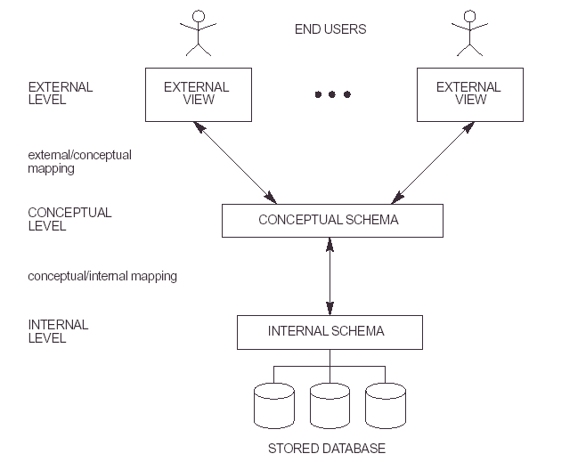
DBMS Architecture and Data Independency

Slide 8
Database Languages
Data Definition Language (DDL)
  Use to specify database schema
Data Manipulation Language (DML)
  Manipulate and access data (e.g. Insert, retrieve, delete, update)
Comprehensive Integrated language
  e.g. SQL
Query Language
  Part of DML to specify how to retrieve data from the database

Slide 9
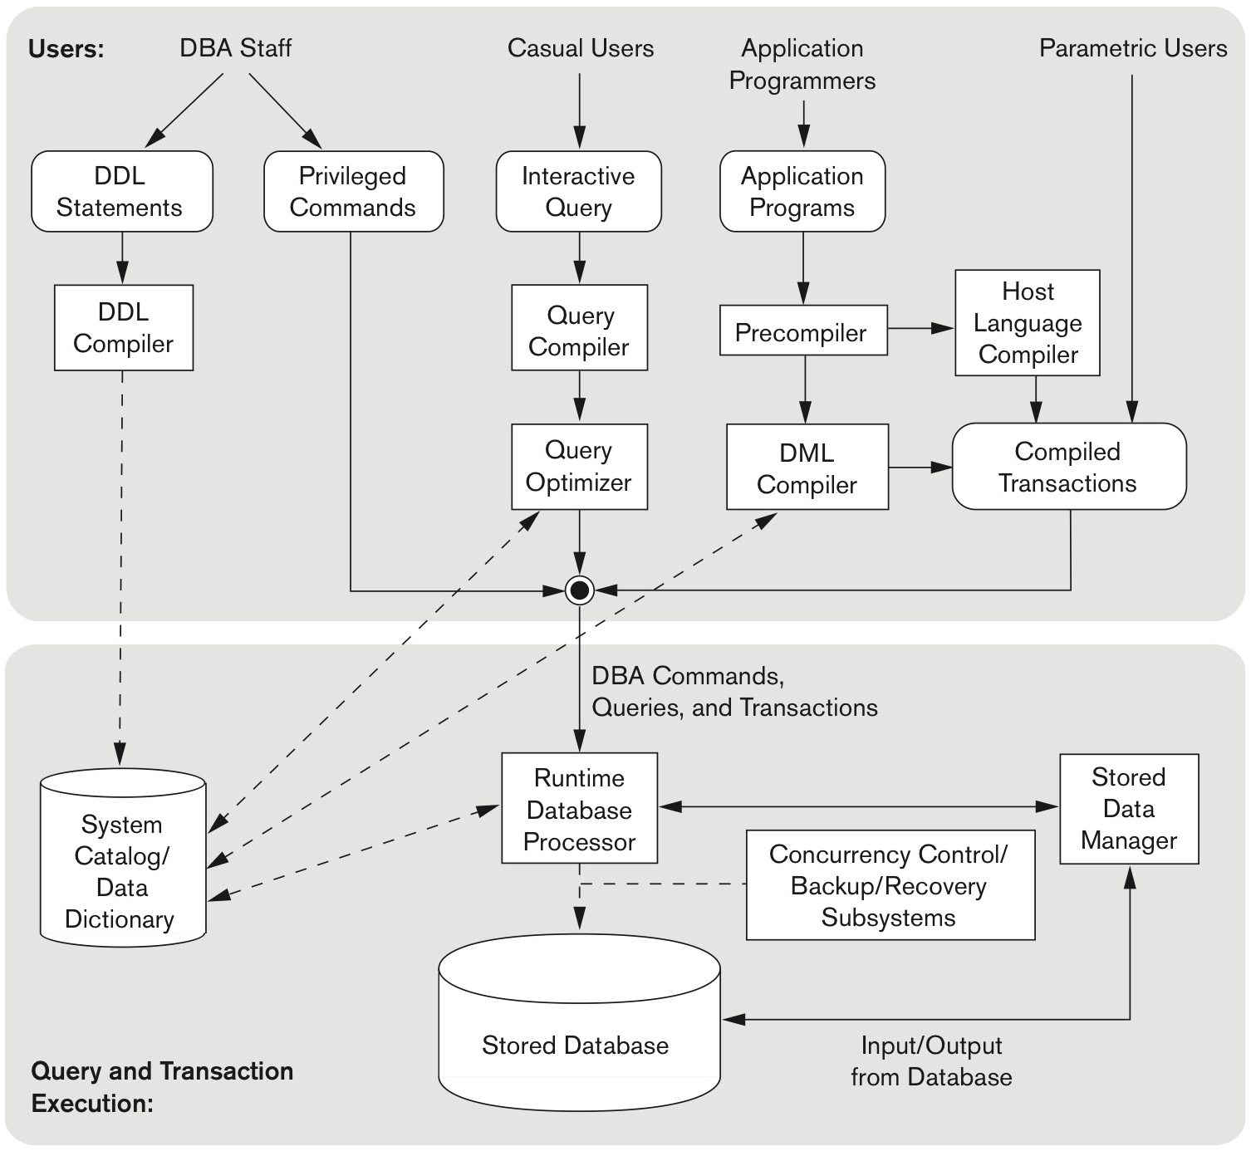
Component modules

Slide 10
Buffer Management
Responsible for allowing processes to get the memory they need
Minimizing the delay
Example
  What block to throw out of the buffer pool when a buffer is needed for a newly requested block? e.g. FIFO

Slide 11
Catalog
Include information of structures:
  Names and sizes of files,
  Names and sizes types of data items,
  Storage details of each file
  Mapping information among schemas and constraints

Slide 12
These slides are based on the textbook:
R. Elmaseri and S. Navathe, Fundamentals of Database Systems, 7th Edition, Addison-Wesley.

